Slide 1


Document to Insight An Overview

Slide 2
Agenda
What is HumanFirst and Prompt x Data (PxD)?
Key conceptual flow within HF
Practical Examples
Data in
Prompt
Insights
Pipeline
Classification Model
Data exploration
Visualisation

Slide 3
https://HumanFirst.ai
A horizontal Prompt and Data (PxD) suite for building AI systems you can trust.
LLM Model family agnostic
Google, Anthropic, OpenAi, Co:here…
Work across wide variety of input material
not limited to any one vertical use case or type of data
Pipeline management across large datasets
Keep a data set enriched with derived insight
Prompt and Classifier design
Derive complex structured insight from unstructured data
Reduce the number of classes an LLM provides to a taxonomy meeting your objectives
Maintain and evolve your solution
Expand granularity, cover new business releases, track model drift.

Slide 4





Conceptual Flow in HF
Documents are regularly loaded into HF forming a dataset
A prompt guides the AI in reading the transcript and following business rules to extract structured data along with evidence for that decision
Pipeline provides caching and automation to maintain a view of that per-document insight across the whole dataset
Classification maps the outputs into a hierarchical taxonomy depending on the intended data use
Cluster
Filter
Explore
Export

Slide 5


SDK or GUI
Full Python SDK for building enterprise workflows https://pypi.org/project/humanfirst/
SDK organised the way the GUI is
Interactively upload your datasets to
explore more insights

Slide 6
Example using Topic report for a conversation Definity

Slide 7
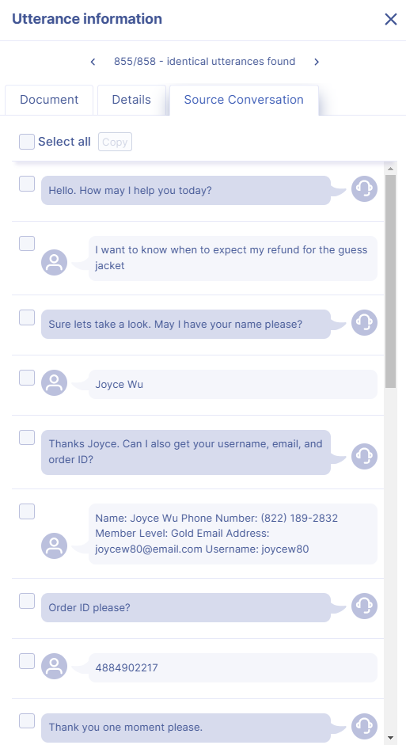
Document
“I want to know when to expect my refund for the guess jacket… I thought you said you only wanted to know the status?... now I changed my mind so answer the question”
A complex document is loaded into HumanFirst
Notes:
ABCD 5532 used for example

Slide 8
Prompt - the idea
Was this conversation fully resolved?
{{ conversation }}
An idea of a prompt is explored, it’s unlikely to be good enough
to produce satisfactory results
The concept “fully resolved” will have different meanings for every person and for every LLM
Notes:
600000006093527

Slide 9
Prompt
The following is a conversation between a "User" and an "Agent" of an online fashion retailer
{{ conversation }}
Your job is to analyse whether this conversation was fully resolved?
Give your reasoning, then your answer as Yes, No or Unclear, followed by a brief one line description of the remaining issue is there is one, or "None" if there is not.
A structured prompt guiding the AI in how to interpret the document and what output is required is prepared and then tuned
Notes:
600000006093527

Slide 10
Prompt tuned(CIDER)
The following is a conversation between a "User" and an "Agent" of an online fashion retailer
<conversation>
{{ conversation }}
</conversation>
Your job is to analyse whether this conversation was fully resolved?
- consider what the users initial request was
- the actions the Agent took to help give it
- the User's reaction to the agent solution
Give your reasoning, then your answer as Yes, No or Unclear, followed by a brief one line description of the remaining issue is there is one, or "None" if there is not.
Respond with plain text key value pairs in this format:
reasoning: [ Reasoning ]
resolved: [ Yes, No or Unclear ]
remaining_issue: [ Your one line summary of remaining issue or None ]
Context
Instructions
Delimiters
Examples here maybe?
A prompt guiding the AI (simplified)
Response Format
Notes:
600000006093527

Slide 11
Insight
resolved | No
remaining_issue | User wants to add an item to their existing refund and confirm the total refund amount, which the agent couldn't address.
reasoning | The conversation was not fully resolved. The user's initial request was to know the status of their refund for a Guess jacket. The agent provided this information, stating the refund was in progress. However, the user then changed their request, wanting to add another item to the refund and inquiring about the total amount. The agent seemed confused by this change and didn't address the new request adequately. The user became frustrated and asked for a manager. The agent's off-the-record comment about not being able to see amounts further indicates they were unable to assist with the user's new request.
The prompt produces the insight including it’s reasoning
Notes:
600000006093527

Slide 12
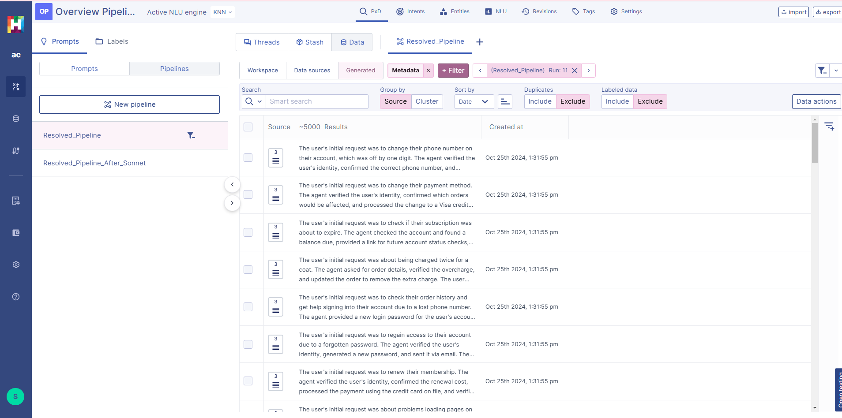
Pipeline
Pipeline caches results, minimising LLM costs Runs prompts at maximum speed LLM allows, handles parallelism and retries
Maintains a view of derived information across whole dataset
Notes:
600000006093527

Slide 13
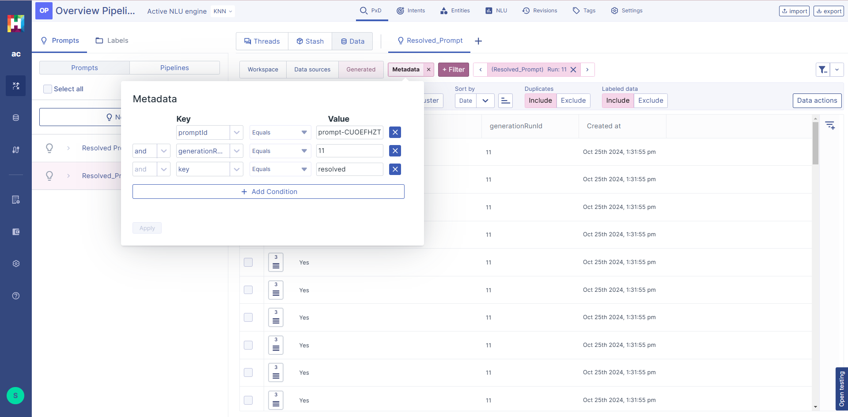
Pipeline - Filtering
Pipelines can be filtered for the final run and the individual keys required
Here we are filtering by resolved and we can filter by resolved=No to discover how many of the 5000 data points are not resolved
Notes:
600000006093527

Slide 14
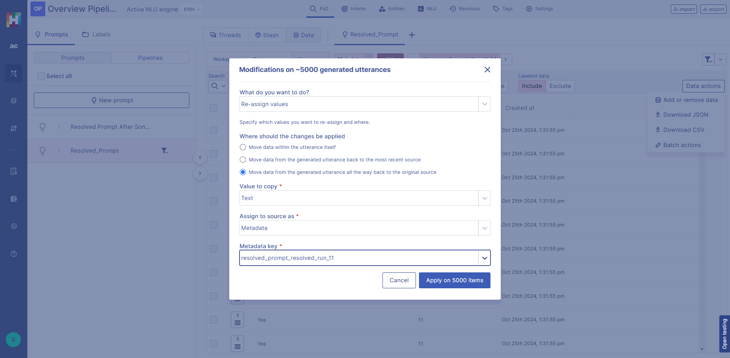
Pipeline - Batch actions
Batch actions move each key back to annotations on the original document - these go onto the initial utterance of the conversation
Notes:
600000006093527

Slide 15
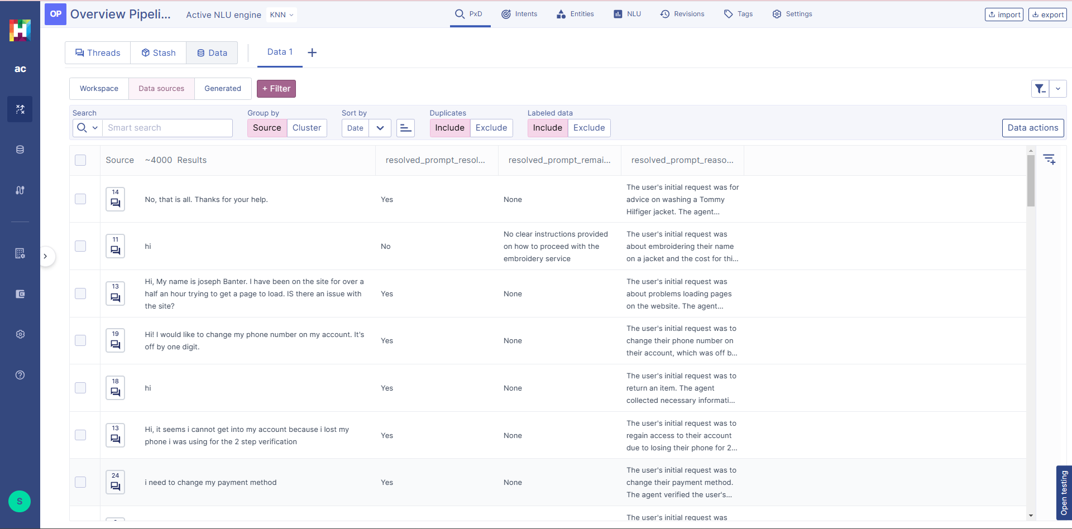
Pipeline - Derived Columnar Data
The original documents can now be displayed, sorted and filtered by the derived data
Notes:
600000006093527

Slide 16
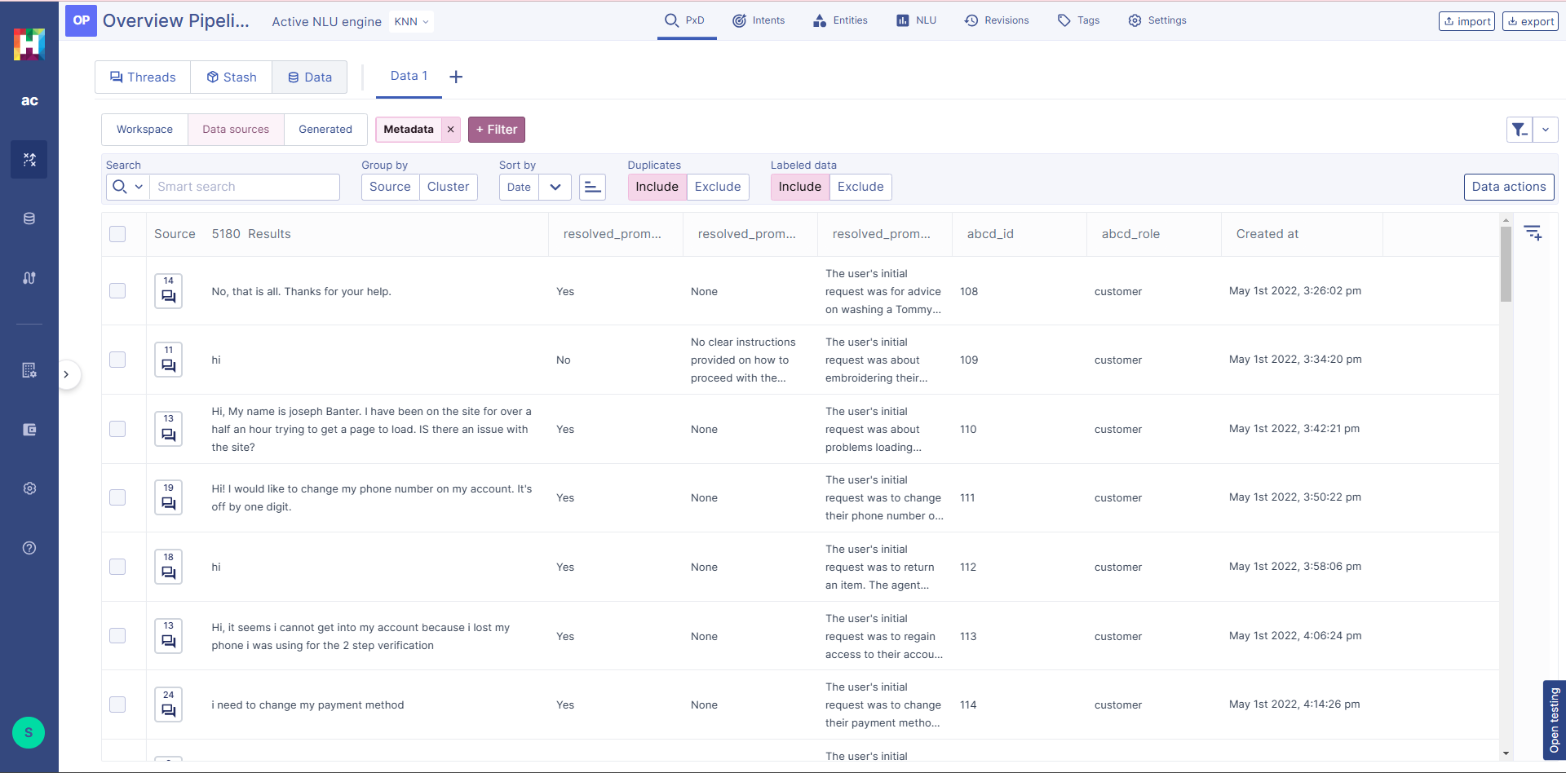
Pipeline - Derived Columnar Data
We can see how many are not resolved, and that we have about 506 out of 5180 and each has subtly different reasons.
What are the key groups here?
Notes:
600000006093527

Slide 17
Classification
Some data, like resolved yes or no, can be instantly used to filter and work with the original documents as it has a small number of distinct values
resolved | No
remaining_issue | User wants to add an item to their existing refund and confirm the total refund amount, which the agent couldn't address.
reasoning | The conversation was not fully resolved. The user's initial request was to know the status of their refund for a Guess jacket. The agent provided this information, stating the refund was in progress. However, the user then changed their request, wanting to add another item to the refund and inquiring about the total amount. The agent seemed confused by this change and didn't address the new request adequately. The user became frustrated and asked for a manager. The agent's off-the-record comment about not being able to see amounts further indicates they were unable to assist with the user's new request.
Some data has almost a different value for every call, but they seem to fall into certain groups we might want to report on. Classification helps to quickly build a model to discover and label classes we are interested in to better use the data in reports and visualisation
Notes:
600000006093527

Slide 18
Classification - download CSV
Download the data as a CSV (all 5180) to upload to group the classes of reasons Ensure have a date and a role column or add them in CSV
Notes:
600000006093527

Slide 19
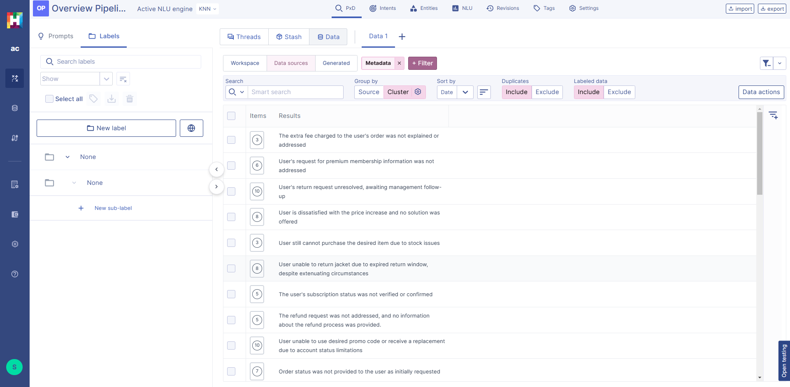
Classification - upload - Cluster
Upload to a new workspace
Clustering helps speed the process of creating a model
Notes:
600000006093527

Slide 20
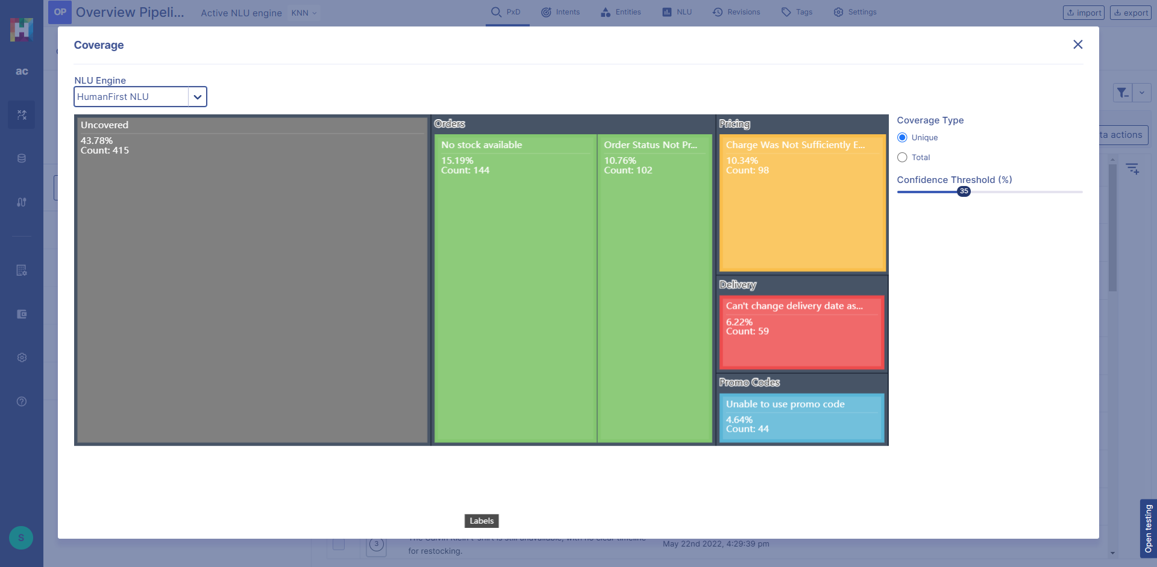
Classification - Grow Coverage
Monitor and increase coverage of the issue model across the dataset
Notes:
600000006093527

Slide 21
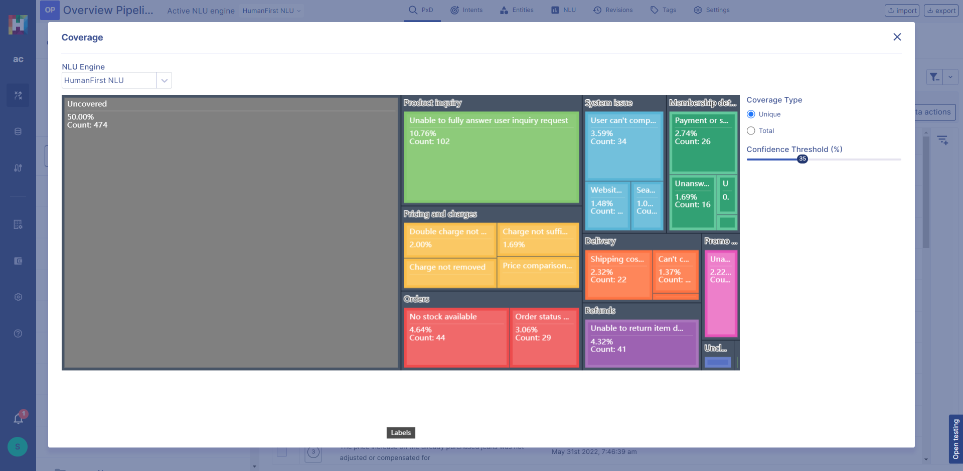
Classification - Growing Coverage
Increasing classes
Notes:
600000006093527

Slide 22
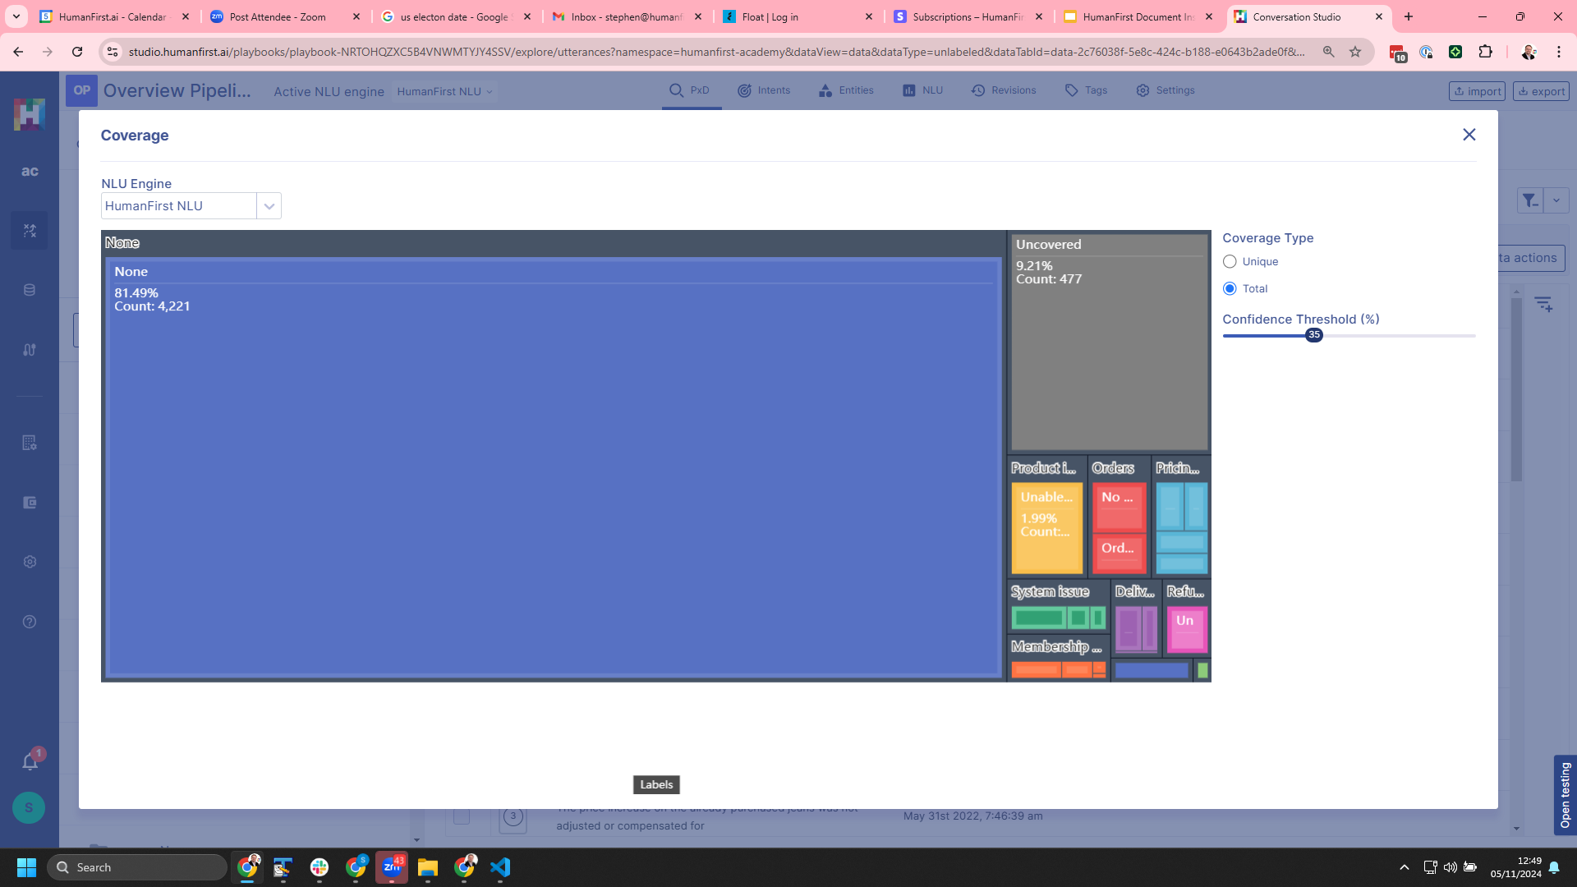
Classification - Total Coverage
Total coverage of set including duplicates (and many have “None” I.e no remaining issue here)
Notes:
600000006093527

Slide 23
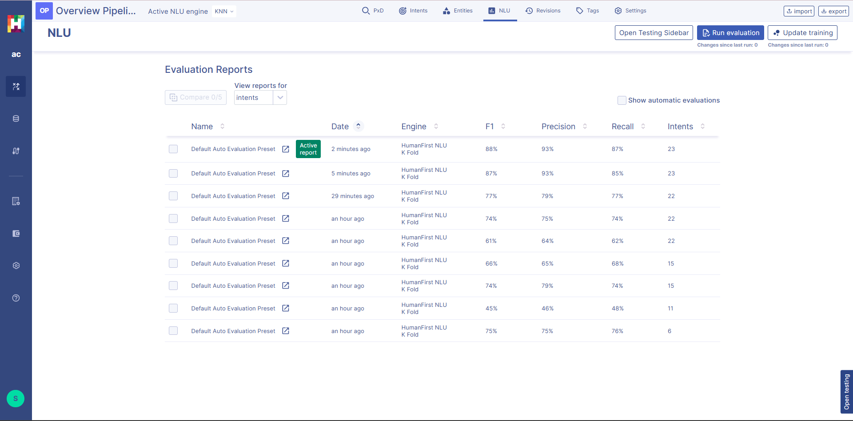
Classification - Model Quality
As you grow the number of classes you discover and label, maintain and improve the quality of the model
Notes:
600000006093527

Slide 24
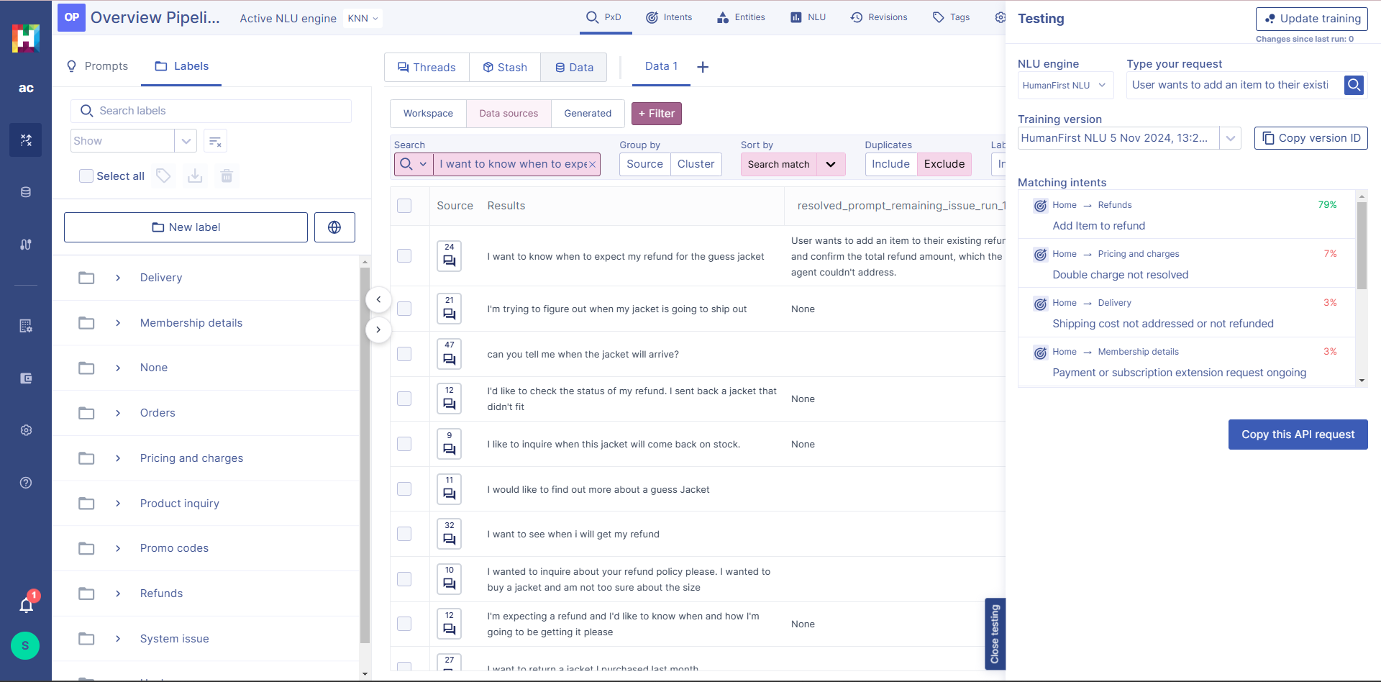
Classification - overall
Individual result is now mapped onto a business verified two level hierarchy
Notes:
600000006093527

Slide 25
Classification - example
“User wants to add an item to their existing refund and confirm the total refund amount, which the agent couldn't address.”
Refunds -> Add item to refund | 79%
Pricing and charges -> Double charge not resolved | 7%
Pricing and charges -> Shipping cost not addressed or not refunded | 3%
Individual result is mapped onto a business verified two level hierarchy
The tool reports the top n (~10) categories. The top category being the most likely is taken when it exceeds a confidence clip
Notes:
600000006093527

Slide 26
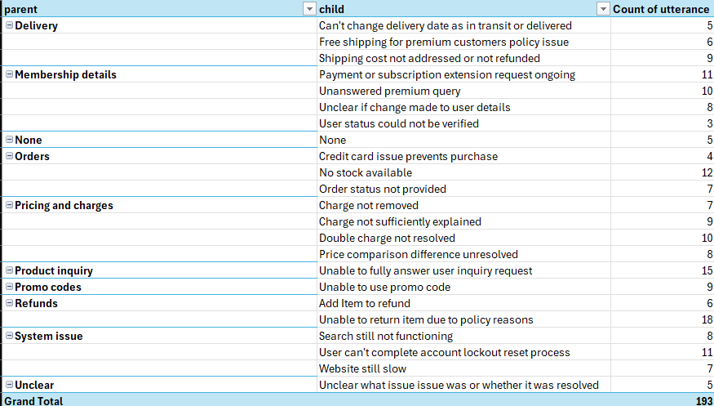
Classification - model summary
Here 2 levels ~10 primary classes
~20-25 sub classes
Notes:
600000006093527

Slide 27
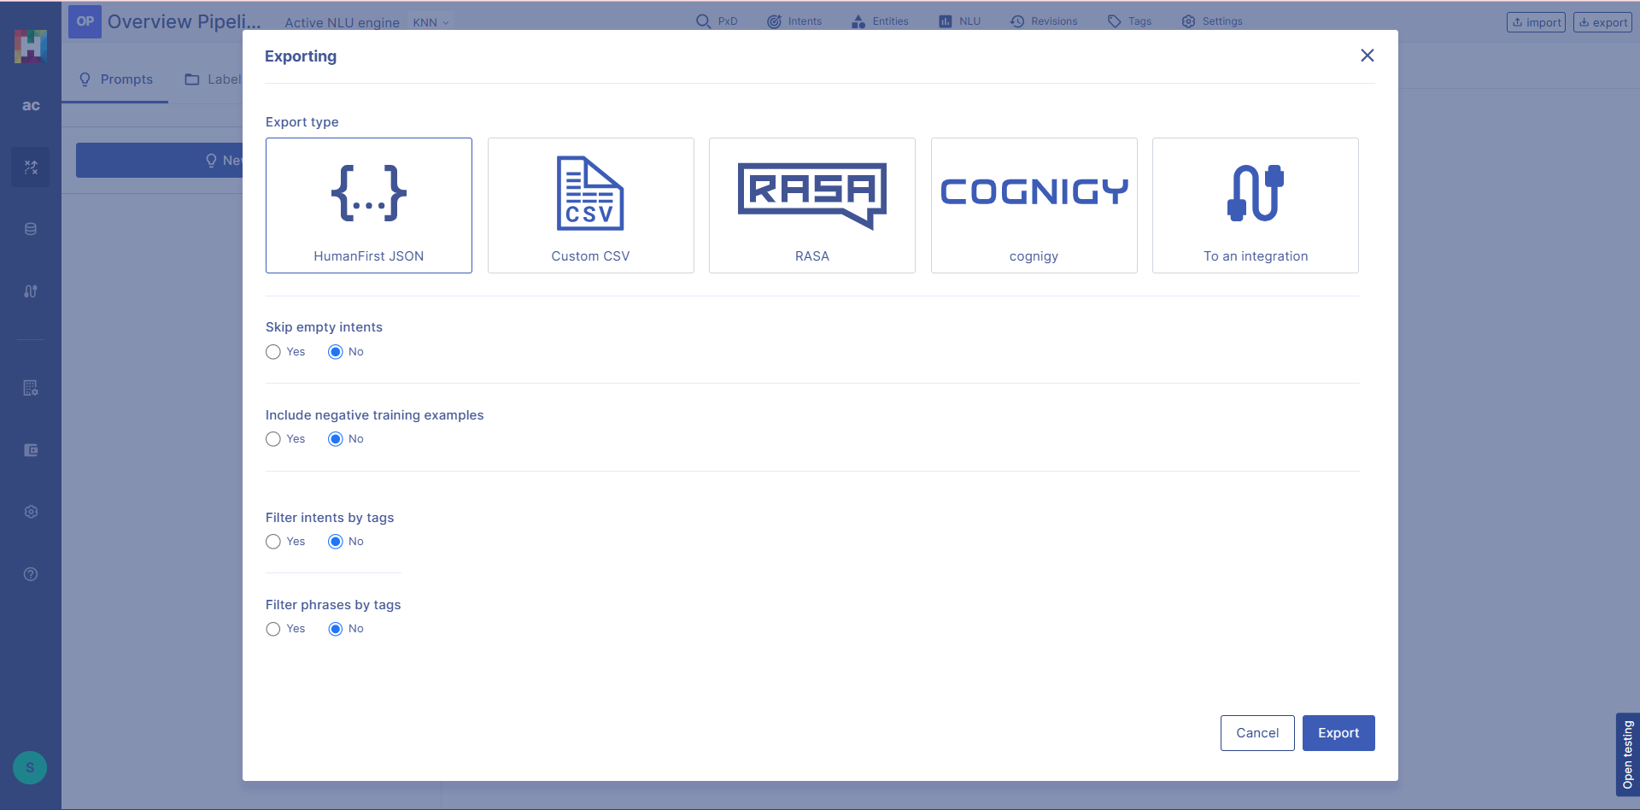
Load model into pipeline
+
Model exported back to main workspace with pipeline Every pipeline result is now automatically evaluated against the classification model
Notes:
600000006093527

Slide 28
Insight aligned with monitoring
Information | Value | Top Matching Class | Top Matching Score
resolved | No
remaining_issue | User wants to add an item to their existing refund and confirm the total refund amount, which the agent couldn't address. | Refunds -> Add item to refund | 79%
reasoning | The conversation was not fully resolved. The user's initial request was to know the status of their refund for a Guess jacket. The agent provided this information, stating the refund was in progress. However, the user then changed their request, wanting to add another item to the refund and inquiring about the total amount. The agent seemed confused by this change and didn't address the new request adequately. The user became frustrated and asked for a manager. The agent's off-the-record comment about not being able to see amounts further indicates they were unable to assist with the user's new request.
Notes:
600000006093527

Slide 29
Validate
Criteria | AI evaluation | Human Evaluation | Result
resolved | No | Yes? | ?
remaining_issue | User wants to add an item to their existing refund and confirm the total refund amount, which the agent couldn't address. = Refunds / Add Item | = Refunds Add Item
reasoning | The conversation was not fully resolved. The user's initial request was to know the status of their refund for a Guess jacket. The agent provided this information, stating the refund was in progress. However, the user then changed their request, wanting to add another item to the refund and inquiring about the total amount. The agent seemed confused by this change and didn't address the new request adequately. The user became frustrated and asked for a manager. The agent's off-the-record comment about not being able to see amounts further indicates they were unable to assist with the user's new request. | The client is being unreasonable
+
Confirm that the criteria for validation are understood…
by the Humans involved
by the AI
And there is a signed off test set confirming this
Notes:
600000006093527

Slide 30
Validate - how many should we do?
91%
Agreement 25 classes - modelled. Absolute minimum one test case per class to establish ground truth What is statistically significant at what confidence for 5000 conversations? (bigger than you think)
+
Consider
Number of classes or output variables
Number of input key types
Statistically significant confidence levels
Notes:
600000006093527

Slide 31
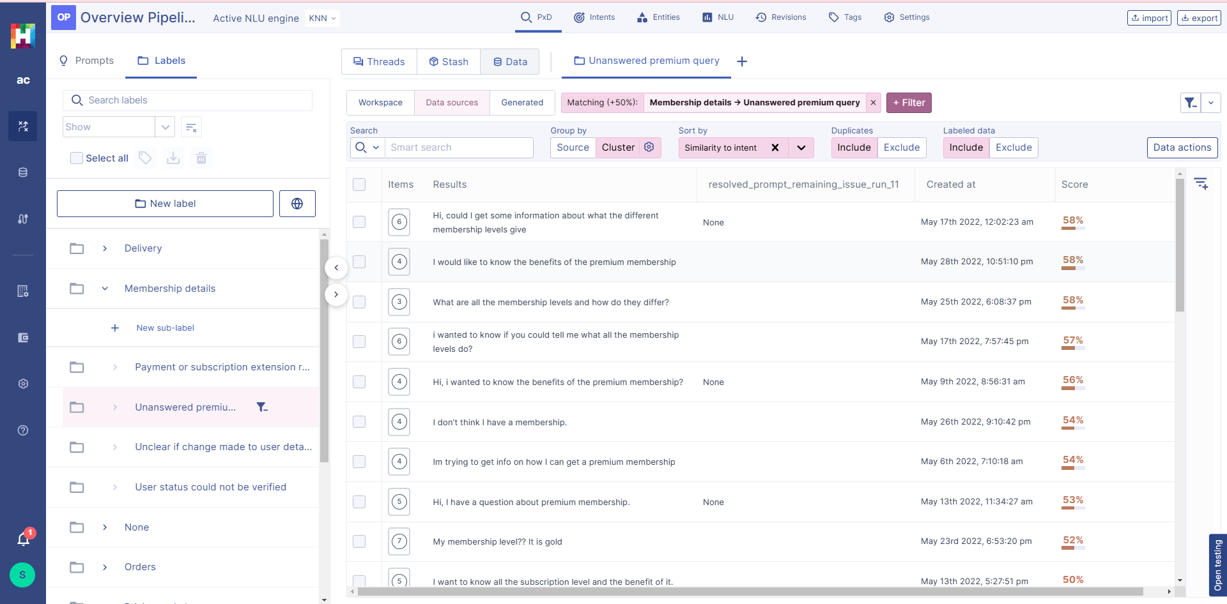
Explore
Cluster
Filter
Explore
Export
Create new models
Answer new questions!
Notes:
600000006093527

Slide 32
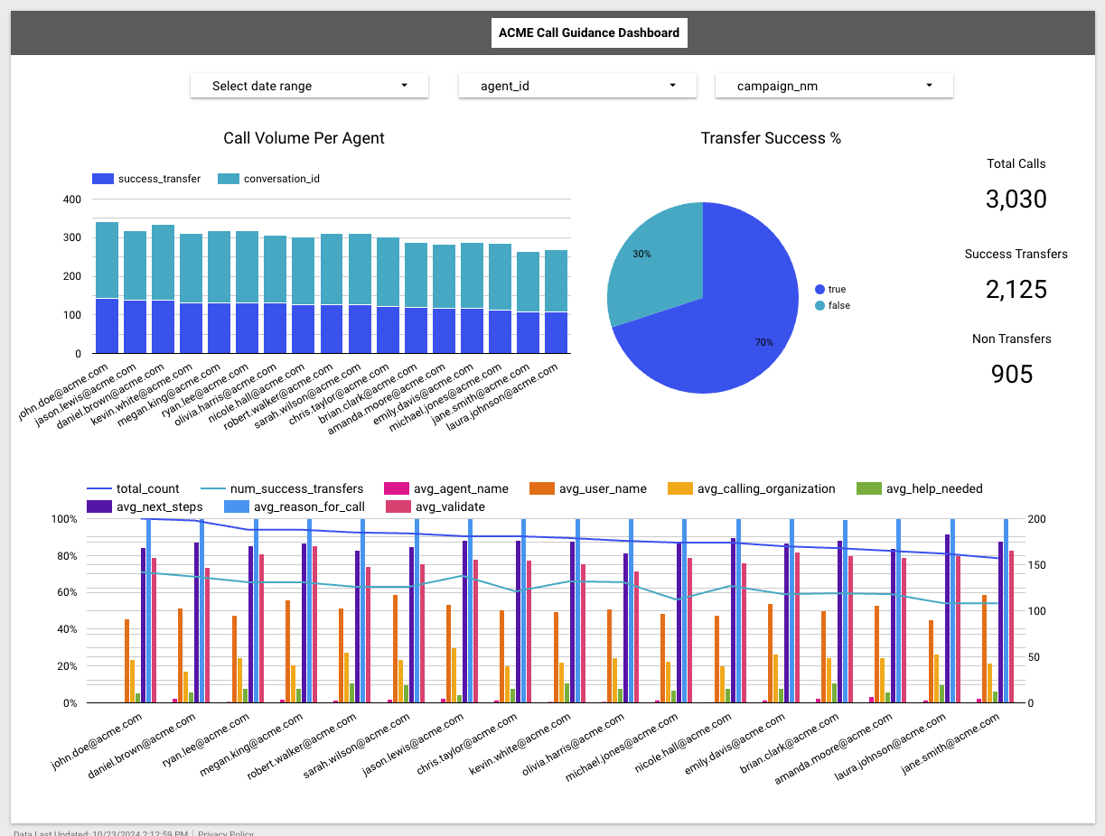
Export
Use APIs to download Pipeline data and analyse in your visualization tool of choice
Notes:
600000006093527

Slide 33
Thank you

